Slide 1
Airline Customer Satisfaction:
Inflight Services
Kyle Christy
April 9, 2023
MKG 581 – Business Intelligence and Data Analytics
Dr. Justin Bateh
Notes:
Today’s presentation we will show how Inflight Services can directly affect an airline customer’s overall satisfaction of their flight experience.

Slide 2
INTRODUCTION
Why is positive customer satisfaction so important to the airline industry?
Recent years have seen a major shift in travel expectations when flying with preferred airlines
Variables can alter a traveler's experience when flying with an airline
Travelers now expect airlines to enhance their in-flight experience
Notes:
Why is positive customer satisfaction so important to the airline industry?
Positive customer satisfaction is important to the airline industry because it is directly tied to the success and profitability of the company.
Satisfied customers are more likely to fly with the airline again, recommend it to others, and leave positive reviews.
On the other hand, dissatisfied customers can lead to negative word-of-mouth, loss of business, and damage to the airline's reputation.
Recent years have seen a major shift in travel expectations when flying with preferred airlines
In recent years, there has been a shift in what travelers expect when flying with their preferred airlines.
Travelers now expect airlines to enhance their in-flight experience, providing amenities such as Wi-Fi, entertainment, and comfortable seating.
Variables can alter a traveler's experience when flying with an airline
There are many different variables that can alter a traveler's experience when flying with an airline, such as flight delays, cancellations, lost luggage, and poor customer service.
Travelers now expect airlines to enhance their in-flight experience
As mentioned earlier, travelers now expect airlines to enhance their in-flight experience.
This means providing amenities such as Wi-Fi, entertainment, comfortable seating, and quality food and drink options.

Slide 3
INTRODUCTION
In-flight experiences can be the ultimate tipping point for customer satisfaction
Customer experience starts from the moment they step into the airport
Customers are generally satisfied when all their complaints are heard and resolved immediately by the airline
Fulfilling customer needs is the best way for airline companies to gain positive satisfaction reviews (Park, 2020)
Notes:
In-flight experiences can be the ultimate tipping point for customer satisfaction
The in-flight experience can be the ultimate tipping point for customer satisfaction.
A positive in-flight experience can greatly enhance the customer's overall satisfaction with the airline, while a negative experience can greatly diminish it.
Customer experience starts from the moment they step into the airport
It's important to note that the customer experience starts from the moment the customer steps into the airport.
This means that airlines must focus on providing a positive experience at every touchpoint, from check-in to baggage claim.
Customers are generally satisfied when all their complaints are heard and resolved immediately by the airline
Customers are generally satisfied when all their complaints are heard and resolved immediately by the airline.
This means that airlines must have a process in place for addressing customer complaints and resolving them quickly and effectively.
Fulfilling customer needs is the best way for airline companies to gain positive satisfaction reviews (Park, 2020)
Finally, fulfilling customer needs is the best way for airline companies to gain positive satisfaction reviews.
By listening to customers and providing what they want and need, airlines can greatly enhance their reputation and attract more business.

Slide 4
Problem/Purpose Statement
The purpose of this research is to identify the effects of in-flight services on a customer's overall satisfaction of their flying experience.
The goal is to identify the correlation between overall satisfaction and in-flight services satisfaction.
This research will provide the airline industry with more knowledge on how in-flight services can positively or negatively affect a traveler's overall satisfaction of the flying experience.
The information gathered will provide companies within the airline industry the opportunity to advance and perfect their in-flight services.
Notes:
The purpose of this research is to investigate the impact of in-flight services on the overall satisfaction of airline customers. We aim to explore the correlation between the satisfaction levels of in-flight services and the overall satisfaction of the flying experience.
This research is important for the airline industry as it will provide valuable insights into how in-flight services can positively or negatively affect a traveler's overall satisfaction. The data gathered from this research will help airline companies to understand the specific aspects of in-flight services that are most important to customers, and will provide them with the opportunity to improve and enhance their in-flight services.
Overall, this research will help the airline industry to meet the evolving needs and expectations of their customers, and to create a more satisfying and enjoyable flying experience for everyone.

Slide 5
Goals and Benefits
The ultimate goal is to provide the airline industry with an analysis of how in-flight food and beverage services have an overall effect on the customer's flying experience.
The research will also provide insight on how another global pandemic like COVID-19 could negatively impact overall in-flight experience satisfaction.
This analysis will help shorter flight airlines like Southwest understand how in-flight food and beverage services impact customer experience for quick flights.
Notes:
-Our ultimate goal with this research is to provide the airline industry with an in-depth analysis of how in-flight food and beverage services have an overall effect on the customer's flying experience.
-Additionally, this research will provide insight on how another global pandemic like COVID-19 could negatively impact overall in-flight experience satisfaction, which is critical information for the airline industry to be prepared for.
-This analysis will also help shorter flight airlines like Southwest understand how in-flight food and beverage services impact customer experience for quick flights, which will be useful for them to make informed decisions about their in-flight services.

Slide 6
Data Set
The dataset used for the report includes variables that impact a person's overall satisfaction of their air travel
Data was collected from random passengers on their most recent flight and scored each variable they experienced during travel
Majority of variables were ranked on a satisfactory level of 0-5, with 5 being the most satisfactory
Demographic variables included in the dataset are sex, age, class traveled, and type of flight (Business/Personal), flight distance, delays on arrival/departure, and overall satisfaction with the trip
Inflight features, airport experience, and boarding process are also variables included in the dataset
Notes:
In conducting this report, we utilized a dataset that includes various variables that have an impact on a person's overall satisfaction of their air travel experience.
To gather the necessary information, we randomly selected passengers and asked them to score each variable they experienced during their travel, with the majority being ranked on a satisfactory level of 0-5, with 5 being the most satisfactory.
Along with the inflight features, airport experience, and boarding process, we included demographic variables in the dataset such as sex, age, class traveled, type of flight (Business/Personal), flight distance, delays on arrival/departure, and overall satisfaction with the trip.
By using this dataset, we hope to provide a thorough analysis of the factors that contribute to customer satisfaction in air travel, and we believe that our findings can help improve the overall flying experience for travelers.

Slide 7
Research Questions/Hypotheses
Does the satisfaction level of in-flight food/drink services have a positive or negative impact on the overall satisfaction level of the customer?
Ho = A negative satisfaction level of in-flight food/drink services has no effect on the overall satisfaction level of the customer.
Ha= The negative satisfaction level of in-flight food/drink services has a negative effect on the overall satisfaction level of the customer.
Does the satisfaction level of in-flight entertainment have a positive or negative impact on the overall satisfaction level of the customer?
Ho = A negative satisfaction level of in-flight entertainment has no effect on the overall satisfaction level of the customer.
Ha= The negative satisfaction level of in-flight entertainment has a negative effect on the overall satisfaction level of the customer.
Does the satisfaction level of in-flight WiFi services have a positive or negative impact on the overall satisfaction level of the customer?
Ho = A negative satisfaction level of in-flight WiFi services has no effect on the overall satisfaction level of the customer.
Ha= The negative satisfaction level of in-flight WiFi services has a negative effect on the overall satisfaction level of the customer.
Notes:
Our Research Questions and Hypotheses are written on this slide:
Does the satisfaction level of in-flight food/drink services have a positive or negative impact on the overall satisfaction level of the customer?
Null - Ho = A negative satisfaction level of in-flight food/drink services has no effect on the overall satisfaction level of the customer.
Alternative -Ha= The negative satisfaction level of in-flight food/drink services has a negative effect on the overall satisfaction level of the customer.
Does the satisfaction level of in-flight entertainment have a positive or negative impact on the overall satisfaction level of the customer?
Null - Ho = A negative satisfaction level of in-flight entertainment has no effect on the overall satisfaction level of the customer.
Alternative Ha= The negative satisfaction level of in-flight entertainment has a negative effect on the overall satisfaction level of the customer.
Does the satisfaction level of in-flight WiFi services have a positive or negative impact on the overall satisfaction level of the customer?
Null Ho = A negative satisfaction level of in-flight WiFi services has no effect on the overall satisfaction level of the customer.
Alternative Ha= The negative satisfaction level of in-flight WiFi services has a negative effect on the overall satisfaction level of the customer.

Slide 8
Limitations and Ethical Considerations
Time constraints can be a limitation
Lack of previous research studies on this topic
COVID-19 pandemic has affected inflight services
Dataset not completely anonymous as customers' rewards numbers are included
Ethical considerations include ensuring data confidentiality and using fake identifiers
Notes:
-Time constraints can be a limitation: As we are limited on the time of when this report will be completed, time constraints can be a limitation when conducting the research.
-Lack of previous research studies on this topic: There is some lack of previous research studies on this particular topic, which may be a limitation.
-COVID-19 pandemic has affected inflight services: Some of the data in the dataset has been collected immediately after the pandemic, and this limits our research openness.
-Dataset not completely anonymous as customers' rewards numbers are included: The dataset we have is not completely anonymous as we have the customers flying rewards numbers.
-Ethical considerations include ensuring data confidentiality and using fake identifiers: It is important to ensure that this data is not made public in our research, or include fake identifiers to protect customer privacy.

Slide 9
Findings
Data analysis shows that different variables impact airline customer's overall satisfaction
SAS Studio used to conduct analysis and generate findings
Findings can help airlines improve in-flight services and customer satisfaction levels
Analysis conducted on inflight WiFi service, inflight food and drink service, and inflight entertainment service
Analysis helps determine alternative hypotheses to be true and provide data to support them
Airlines can use this analysis to make improvements and increase overall satisfaction
Notes:
-Data analysis shows that different variables impact airline customer's overall satisfaction
-SAS Studio used to conduct analysis and generate findings
-Findings can help airlines improve in-flight services and customer satisfaction levels
-Analysis conducted on inflight WiFi service, inflight food and drink service, and inflight entertainment service
-Analysis helps determine alternative hypotheses to be true and provide data to support them
-Airlines can use this analysis to make improvements and increase overall satisfaction

Slide 10
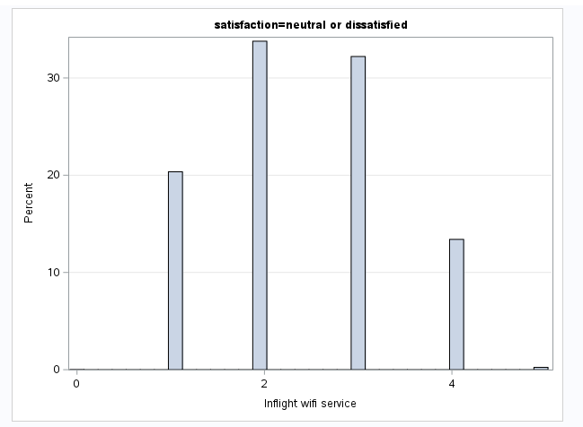
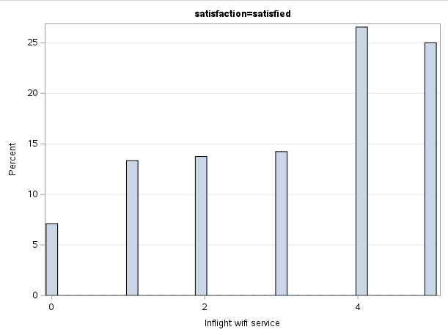
Findings
Figure 1
Notes:
Figure 1 shows the inflight WiFi service data ranked 1-5, 1 being dissatisfied and 5 being very satisfied, as it pertains to the rankings of overall neutral or dissatisfied and those they were overall satisfied. We can see that the overall satisfied airline customers ranked 4/5 on inflight WiFi service. Whereas the dissatisfied customers ranked inflight WiFi service at the 1, 2, and 3 levels.

Slide 11
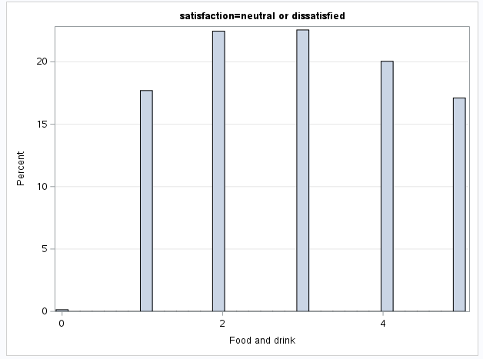
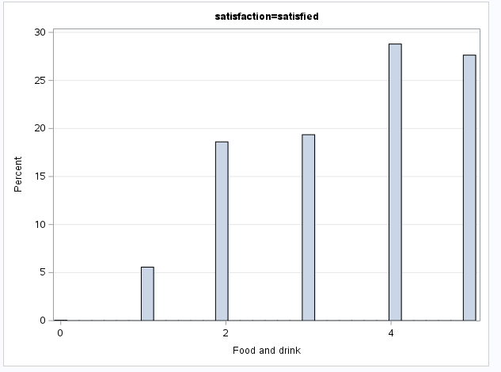
Findings
Figure 2
Notes:
Figure 2 shows the inflight food and drink service data ranked 1-5, 1 being dissatisfied and 5 being very satisfied, as it pertains to the rankings of overall neutral or dissatisfied and those they were overall satisfied. We can see that the overall satisfied airline customers ranked 4 and 5’s on inflight food and drink service. Whereas the dissatisfied customers ranked inflight food and drink service at the 1, 2, and 3 levels.

Slide 12
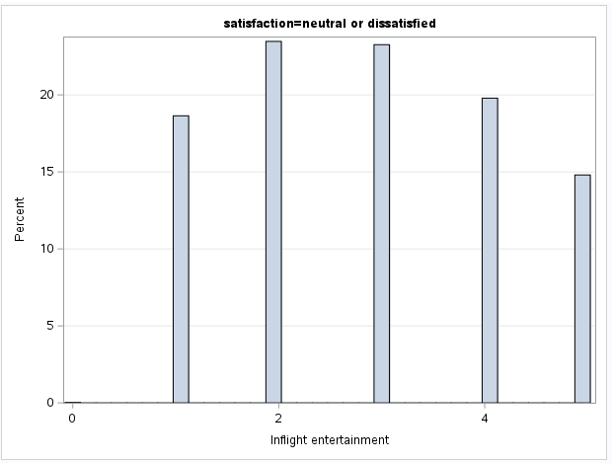
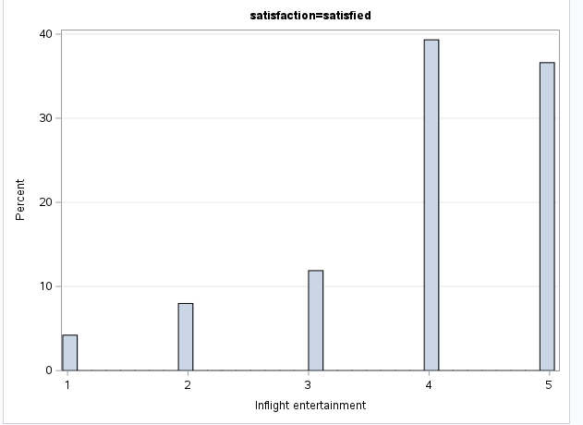
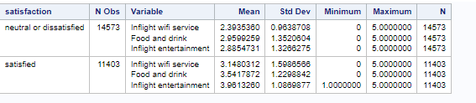
Findings
Figure 3
Figure 4
Notes:
figure 3 shows the inflight entertainment service data ranked 1-5, 1 being dissatisfied and 5 being very satisfied, as it pertains to the rankings of overall neutral or dissatisfied and those they were overall satisfied. We can see that the overall satisfied airline customers ranked 4 and 5’s on inflight entertainment service. Whereas the dissatisfied customers ranked inflight entertainment service at the 1, 2, and 3 levels.
Lastly, Figure 4 shows us the average score rating for each variable analyzed, both under the overall dissastified customer and the overall satisfied customer. We can see with the data that there is indeed a signifigance in the data that shows a higher rating in inflight services does impact the overall satifiaction of the airline customer.

Slide 13
Recommendations
In-flight services impact customer satisfaction
Airlines need to stand out in a competitive market
Food/Drink Services
Quality of food and drink services increases with longer flights
Customer satisfaction is influenced by food and drink services
Trend of quality food and drink services is increasing
WiFi Services
Lack of Wi-Fi services can lead to lower satisfaction
Airline companies need to make Wi-Fi available at all times
Conclusion
Airline companies need to prioritize quality services
Improving services can lead to increased satisfaction levels and a competitive edge.
Notes:
Our analysis shows that in-flight services impact customer satisfaction:
In a competitive market, airlines need to stand out
Quality of food and drink services should increase with longer flights to improve customer satisfaction
The trend of quality food and drink services is increasing, and airlines should follow it
Lack of Wi-Fi services can lead to lower satisfaction, and airline companies need to make Wi-Fi available at all times
Airline companies need to prioritize quality services to increase satisfaction levels and gain a competitive edge.
These recommendations are based on the findings of our data analysis, and they can help airlines improve their in-flight services and customer satisfaction levels. By focusing on the quality of food and drink services, making Wi-Fi available at all times, and prioritizing customer satisfaction, airlines can differentiate themselves from competitors and attract more customers.

Slide 14
References
Ang, S. (2014). The research question. SAGE Publications Ltd, https://doi.org/10.4135/9781473909694
An, M., & Noh, Y. (2009). Airline customer satisfaction and loyalty: impact of in-flight service quality. Service Business, 3, 293-307.
Baskas, H. (2018, May 30). Customer satisfaction with airlines is rising - as long as the Inflight Entertainment Is good. NBCNews.com. Retrieved April 2, 2023, from https://www.nbcnews.com/business/travel/customer-satisfaction-airlines-rising-long-inflight-entertainment-good-n878626
Bhandari, P. (2022, November 17). Ordinal Data: Definition, examples, Data Collection & Analysis. Scribbr. Retrieved March 12, 2023, from https://www.scribbr.com/statistics/ordinal-data/
Bhandari, P. (2022, December 2). Ethical considerations in research: Types &amp; examples. Scribbr. Retrieved March 26, 2023, from https://www.scribbr.com/methodology/research-ethics/

Slide 15
References
Bolonkin, Alexander. (2007). Passenger Life-Saving in a Badly Damaged Aircraft Scenario. Aircraft Engineering and Aerospace Technology. 80. 10.1108/00022660810911554.
Frost, J. (2022, September 4). Ordinal Data: Definition, examples & analysis. Statistics By Jim. Retrieved March 12, 2023, from https://statisticsbyjim.com/basics/ordinal-data/
Greener, S. (2018). Research limitations: the need for honesty and common sense. Interactive Learning Environments, 26(5), 567-568.
Hulme, K. (2022, May 12). Study shows American air travelers aren't happy: Here's why. Travel Off Path. Retrieved March 5, 2023, from https://www.traveloffpath.com/study-shows-american-air-travelers-arent-happy-heres-why/
J.D. Power. (2022, May 11). 2022 North America Airline Satisfaction Study. Retrieved March 5, 2023, from https://www.jdpower.com/business/press-releases/2022-north-america-airline-satisfaction-study
Lee, P.H., Yu, P.L. (2013). An R package for analyzing and modeling ranking data. BMC Med Res Methodol 13, 65 https://doi.org/10.1186/1471-2288-13-65
Park, S., Lee, J. S., & Nicolau, J. L. (2020). Understanding the dynamics of the quality of airline service attributes: Satisfiers and dissatisfiers. Tourism management, 81, 104163. https://doi.org/10.1016/j.tourman.2020.104163
Seyed Mojib Zahraee, Nirajan Shiwakoti, Hongwei Jiang, Zhuoqun Qi, Yunfeng He, Tianan Guo, Yifeng Li,A study on airlines’ responses and customer satisfaction during the COVID-19 pandemic,International Journal of Transportation Science and Technology, ISSN 2046-0430, https://doi.org/10.1016/j.ijtst.2022.11.004.

